Slide 1
Overview of Research Methodology
Chapter 1 Introduction
5 January 2026
Khairul Fikri Tamrin
Email: tkfikri@unimas.my
Phone: 011-15653090

Slide 2
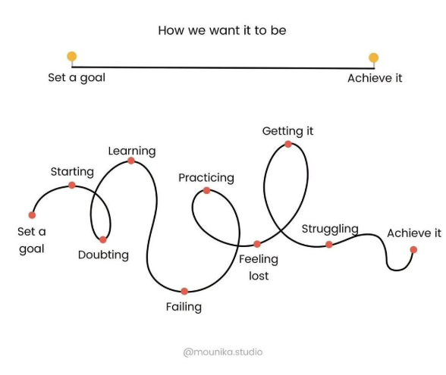
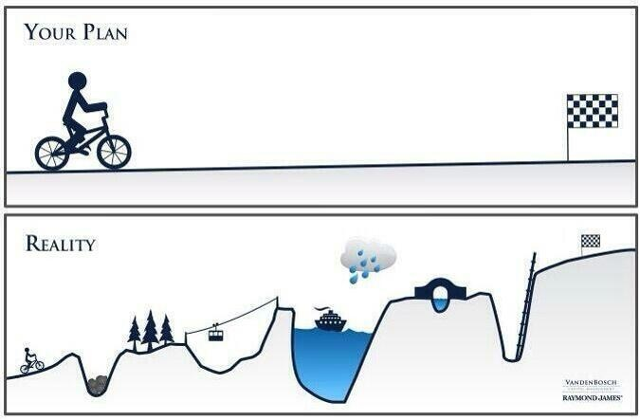
Dream vs Reality

Slide 3
Chapter 1: Introduction
1.1 Background of Study
1.2 Problem Statement
1.3 Research Questions
1.4 Hypotheses
1.5 Objectives of Study
1.6 Scope of Study
1.7 Significance of Study
1.8 Organization of Study
Typical structure
UNIMAS New Thesis Template for Masters and PhD

Slide 4
Workflow
Literature review (Chapter 2)
Research Gap (Chapter 2)
Problem Statements (Chapter 1)
Research Questions (Chapter 1)
Hypotheses (Chapter 1)
Objectives (Chapter 1)

Slide 5
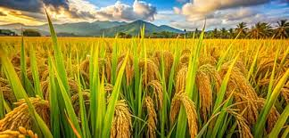
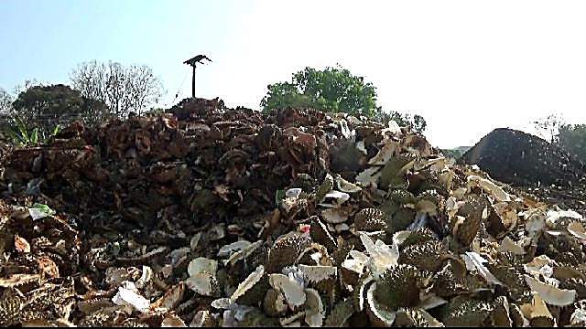
Problem Statement
Describes an important issue, real-world limitation or challenge
Explains why the problem matters, who is affected and what the consequences are if the problem remains unsolved
Sets the motivation for the research

Slide 6
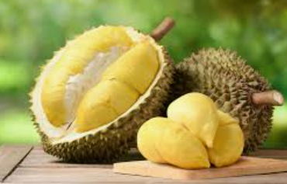
Problem Statement vs Research Gap
Thesis title | Problem Statement in Chapter 1 | Research Gap in Chapter 2
 | A real-world limitation or challenge | A specific lack of scientific knowledge or methodological capability in the existing literature
Mechanical Behaviour and Reinforcement Mechanisms of Durian Skin Fiber–Reinforced Concrete | There is a growing interest in natural fiber–reinforced concrete for sustainable construction. In Malaysia, durian skin waste represents a largely untapped resource with potential value in cementitious composites. However, the performance of such materials is highly variable due to inconsistent fiber properties and limited understanding of fiber–matrix interactions. | There are limited studies reported in the literature that provide insight into the controlled design of durian skin fiber–reinforced concrete, the relationship between its microstructure and mechanical performance, and the fundamental reinforcing mechanisms involved. These knowledge gaps hinder the optimization and wider adoption of this material, thereby motivating the present study.

Slide 7
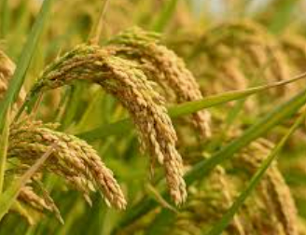
Problem Statement vs Research Gap
Thesis title | Problem Statement in Chapter 1 | Research Gap in Chapter 2
 | A real-world limitation or challenge | A specific lack of scientific knowledge or methodological capability in the existing literature
Laser-Based Soil Spectroscopy and Machine Learning for Optimizing Fertilizer Application in Paddy Cultivation | Despite the importance of accurate soil nutrient assessment for sustainable paddy cultivation, current laboratory-based soil analysis methods are time-consuming and unsuitable for rapid field-level decision-making. | There is a lack of field-deployable systems for the rapid determination of soil nutrients in paddy fields. Furthermore, the quantitative validity of such systems relative to conventional analytical techniques has not been sufficiently established. In addition, the integration of laser-based soil sensing data with machine learning models for predicting optimal fertilizer application rates remains underexplored. Addressing these gaps is essential for enabling precision nutrient management in paddy cultivation.

Slide 8
Research Questions (RQs)
What you want to find out to achieve the objectives
Preferably, research questions are directly mapped one-to-one with the objectives
Clear, specific, and investigable

Slide 9
Hypotheses
Testable predictions answering the RQs
Required mainly for quantitative / experimental studies
Not always needed for exploratory or design-focused research
Must be statistically testable

Slide 10
Hypotheses
Example 1
H₀: There is no significant correlation between light intensity and metal concentration.
H₁: There is a significant correlation between light intensity and metal concentration.
Example 2 (commonly used in engineering)
It is hypothesised that light intensity exhibits a statistically significant correlation with metal concentration.
Example 3
This study hypothesises that the light intensity is significantly correlated with metal concentration.

Slide 11
RQs - Hypotheses - Objectives
Sample PhD 1
Research questions | Hypothesis | Objectives
1. Can laser-based soil analysis techniques be used to generate a spatially resolved soil fertility map for paddy fields? | 1. Laser-based soil analysis can successfully capture spatial variations in soil fertility parameters, enabling the development of a high-resolution soil fertility map for paddy fields. | 1. To develop a novel laser-based soil fertility map for paddy fields
2. How accurately does the laser-based soil fertility map represent soil fertility parameters when compared with conventional laboratory-based soil analysis methods? | 2. The laser-based soil fertility map shows strong agreement with conventional soil analysis techniques, with no statistically significant differences in key fertility parameters. | 2. To validate the developed soil fertility map with the conventional techniques
3. Can machine learning models trained on laser-based soil fertility data accurately predict optimum fertilizer application rates for paddy cultivation? | 3. Machine learning models using laser-derived soil fertility parameters can accurately predict optimum fertilizer application rates comparable to conventional rule-based fertilizer recommendation approaches. | 3. To predict the optimum fertilizer application rates using machine learning

Slide 12
RQs - Hypotheses - Objectives
Sample PhD 2
Research questions | Hypothesis | Objectives
1. How do different 2D passive micromixer geometries influence liquid mixing efficiency in point-of-care (PoC) applications? | 1. 2D-structured passive micromixers with enhanced geometric features can achieve significantly higher mixing efficiency compared to simple straight microchannels. | 1. To investigate the liquid mixing performance of 2D-structured passive micromixers for utilization in PoC
2. What is the achievable and stable flow rate range of passive micropumps for PoC applications? | 2. Passive micropumps can deliver stable and repeatable flow rates with performance influenced by microchannel geometry and pressure-driven conditions. | 2. To investigate the flow rate performance of passive micropumps for utilization in PoC
3. How the integrated passive micromixer and passive micropump in the form of PoC can be optimized for enhanced fluid mixing? | 3. Enhanced mixing performance of the integrated passive micromixer-micropump can be achieved by determining the optimum gauge pressure. | 3. To optimize the gauge pressure via CFD simulation for enhanced mixing performance in the proposed PoC unit

Slide 13
RQs - Hypotheses - Objectives
Sample MSc 1
Research questions | Hypothesis | Objectives
1. How smartphone and laser can be combined to measure glucose levels in urine? | 1. A smartphone and laser, combined with optical-based refractometry, can be designed to measure the refractive index in urine. | 1. To design and fabricate a smartphone-based laser refractometer for non-intrusive measurement of glucose in urine.
2. What is the effects of volume variation, turbidity and shelf-life of urines on measurement results? | 2. Volume variation, turbidity and shelf-life of urines have no effect on the measurement results. | 2. To calibrate the developed glucometer, accounting for variations in urine volume, turbidity and shelf-life.
3. How accurately does the developed laser-based glucometer measure glucose concentration in urine compared to standard laboratory analysis? | 3. The developed laser glucometer can measure urinary glucose concentrations with accuracy comparable to standard laboratory method and demonstrates a strong correlation. | 3. To assess the efficacy of the developed laser glucometer for glucose measurement in urine and compare with laboratory results.

Slide 14
RQs - Hypotheses - Objectives
Sample MSc 2
Research questions | Hypothesis | Objectives
1. What are the optimum laser parameters for drying black pepper berry to achieve the optimum drying characteristics? | 1. An optimum drying speed with suitable laser power and number of laser passes would produce excellent drying characteristics of black pepper berry. | 1. To experimentally investigate the optimum parameters in laser drying process of pepper berries by response surface methodology.
3. How to design an effective set of experiments and optimize the laser drying parameters with respect to drying characteristics? | 2. RSM optimization paired with Box–Behnken design (BBD) can be employed to achieve the optimum drying quality of black pepper berry by laser drying.
3. How does laser processing affect the physico-chemical properties and thermal characteristics of berries compared to untreated berries? | 3. High laser power and low drying speed would result in ablation and burning of black pepper berry. | 2. To evaluate the physico-chemical and thermal characteristics of the laser-processed berries.

Slide 15
Research Objectives
What you intend to achieve
Derived from the problem statement
Guide the entire study
Some thesis examiners emphasise appropriate Bloom’s taxonomy verbs in research objectives
Some thesis examiners emphasise on SMART (Specific, Measurable, Achievable/Attainable, Relevant/Realistic, and Time-bound)

Slide 16
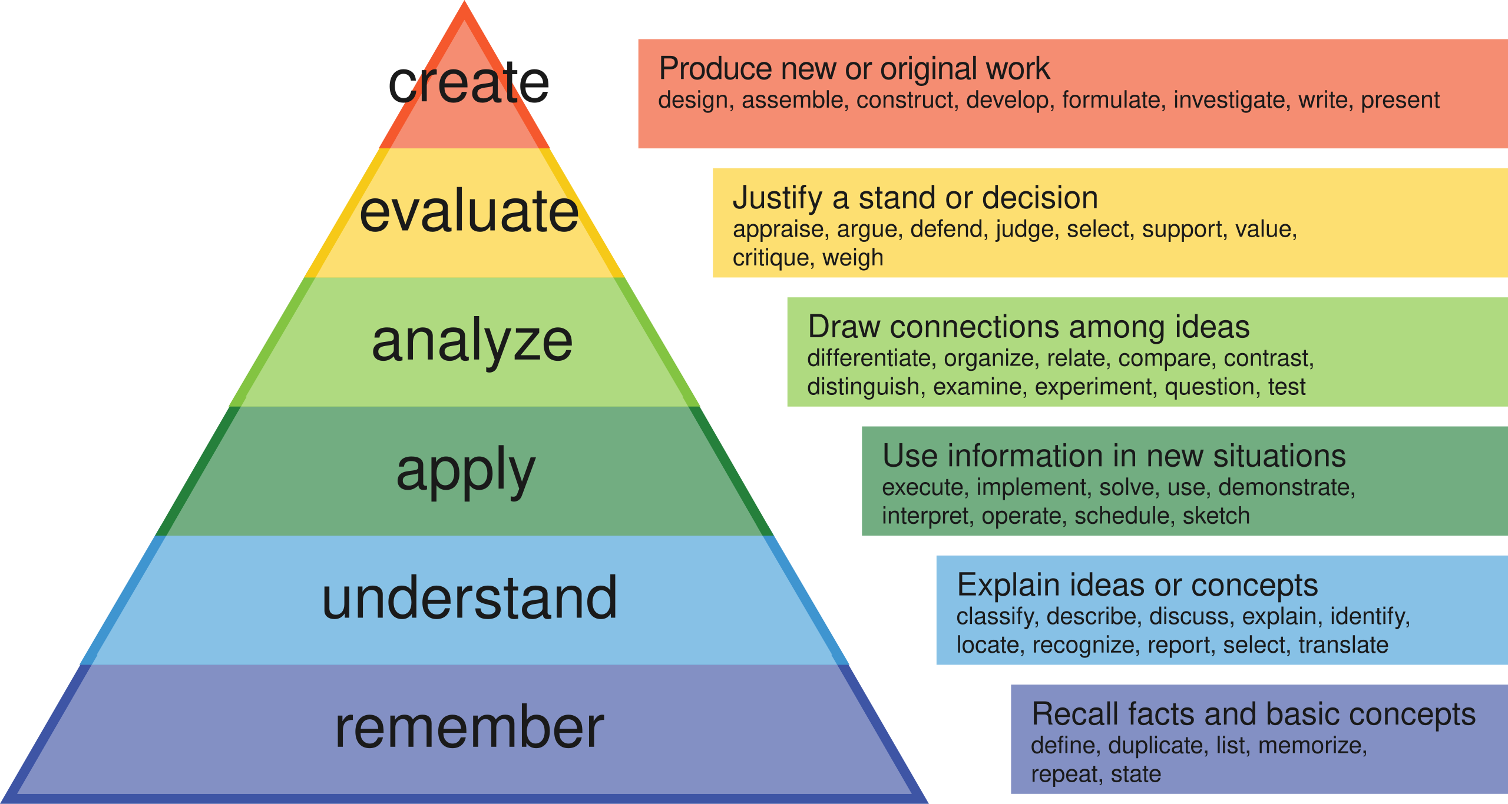
Bloom’s taxonomy
Higher cognitive level
Lower cognitive level
Link

Slide 17
Research Objectives
Objective 1
Objective 2
Objective 3
Objective 1
Objective 2
Objective 3
All objectives are related and show continuity
However, the study does NOT progress in depth from Objective 1 to Objective 3.
This may result in a major correction for the PhD
All objectives are related and demonstrate continuity
The study progresses in depth from Objective 1 to Objective 3
The focus is progressively narrowed

Slide 18
Research Objectives
Example A | PhD | Masters
Objective 1 | To design and fabricate a novel durian skin fiber–reinforced concrete with controlled material composition and processing parameters | To create a novel fiber composite using durian skin
Objective 2 | To investigate the structure–property relationships governing the mechanical performance of durian skin fiber–reinforced concrete | To characterize the mechanical and structural properties of the novel fiber composite
Objective 3 | To elucidate the reinforcing mechanisms of durian skin fibers within the concrete matrix
PhD expectations
Original material and controlled design
New knowledge (structure–property relationship)
Mechanistic understanding (core PhD contribution)
Acceptable for Masters
Material fabrication
Standard characterization

Slide 19
Research Objectives
Example B | Good | Not-so-good
Objective 1 | To develop a novel laser-based soil spectrometer for paddy fields | To design, build and calibrate a novel laser-based soil spectrometer for paddy fields in Sarawak
Objective 2 | To validate the developed laser-based soil spectrometer with the conventional techniques | To investigate the nutrient content of soil using conventional techniques
Objective 3 | To predict the optimum fertilizer application rates using machine learning | To assess the accuracy and reliability of the developed laser-based soil spectrometer for soil nutrient analysis
Acceptable for PhD
New knowledge on relationship between light, nutrient deficiency and fertilizer requirement
Acceptable for Masters
Shallow for PhD since Objectives 1 and 2 can be combined
No new knowledge

Slide 20
Research Objectives
Example C | Good | Not-so-good
Objective 1 | To investigate the liquid mixing performance of 2D-structure passive micromixers for utilization in point-of-care (PoC) | To experimentally characterize two distinct novel micromixers for non-conductive and conductive liquids
Objective 2 | To investigate the flow rate performance of passive micropumps for utilization in PoC | To experimentally characterize two different novel passive micropumps operating at sub-atmospheric and atmospheric pressures
Objective 3 | To optimize the gauge pressure via CFD simulation for enhanced mixing performance in the proposed PoC unit | To compare the performances of the developed micromixers and micropumps with the literature
Objective 3 does not add any new knowledge for PhD

Slide 21
Scope of Study
Determines your research boundary
Parameters selection
Range of parameters
Sample type
Sample size
Duration
Location
Composites
Fiber reinforcement
Natural vs Synthetic
Durian

Slide 22
Thank You

