Slide 1

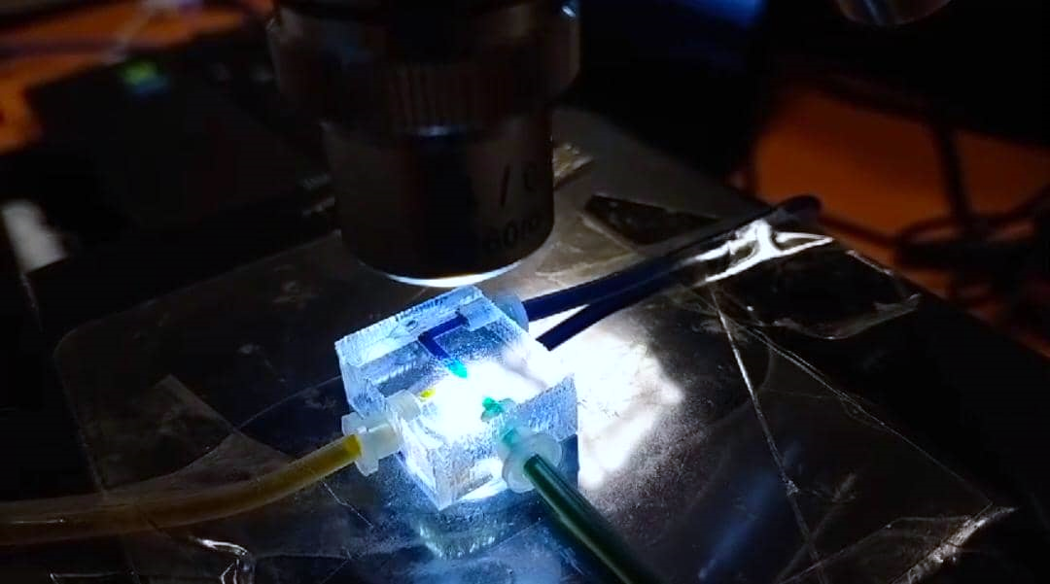
Investigation on Mixing Performance and Droplet Generation of Dissimilar Liquids through T-junction and Offset T-junction Microchannels
NAME: HAWA ANAK RINGKAI MATRIC NO.: 19020160
SUPERVISOR: IR DR KHAIRUL FIKRI BIN TAMRIN

Slide 2

Presentation Overview
1. Research Background
2. Problem Statement
5. Objectives
6. Methodology
7. Results
9. References
8. Conclusion
10. Publications
3. Scope of study
4. Hypothesis

Slide 3
Research Background
Applications of microfluidic device
Micromixing
Droplet
generation
Figure 1: Microfluidic device applications

Slide 4
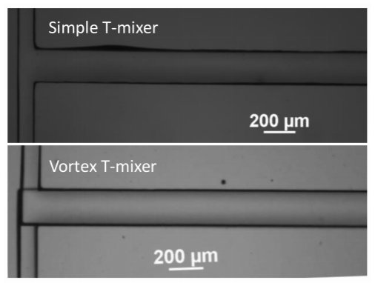
Research Background - Micromixing
Figure 2: Microfluidic device for water-water micromixing (Ansari et al., 2018)

Slide 5
Research Background - Micromixing
  To improve the efficiency of mixing by reducing the characteristics size of microscale devices within shorter mixing channels.
  To reduce the cost of laboratory equipment as it diminishes the consumption of specimens.
  To achieve quick and complete mixing of different samples especially in the microfluidic devices.

Slide 6
Research Background - Micromixing
Table 1: Micromixing past studies
 | Title | Methodology
Wang et al. (2012) | Visualization of micro-scale mixing in miscible liquids using μ-LIF technique and drug nano-particle preparation in T-shaped micro-channels | Similar liquids: Water-water Dissimilar liquids: water-ethanol
Orsi et al. (2013) | Water–ethanol mixing in T-shaped microdevices | Numerical method Dissimilar liquids: Water-ethanol
Solehati et al. (2014) | Numerical investigation of mixing performance in microchannel T-junction with wavy structure | Numerical method
Ansari et al. (2018) | Numerical and experimental study on mixing performances of simple and vortex micro T-mixers | Similar liquids: Water-water
Dundi et al. (2019) | Characterization of enhanced liquid mixing in T‐T mixer at various Reynolds numbers | Numerical method Similar liquids: Water-water
Zhang et al. (2019) | Investigation of three-dimensional flow regime and mixing characteristic in T-jet reactor | Numerical method Similar liquids: Water-water

Slide 7
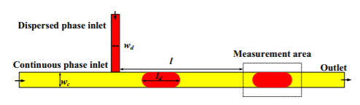
Research Background – Droplet Generation
Figure 3: Microfluidic device for generation of water-in-oil droplets (Liu et al., 2017)

Slide 8
Research Background – Droplet Generation
Table 2: Droplet generation past studies
 | Title | Factors
Zhu et al. (2016) | Droplet generation in co-flow microfluidic channels with vibration | Mechanical vibration
Liu et al. (2017) | Micro-PIV investigation of the internal flow transitions inside droplets traveling in a rectangular microchannel | Viscosity ratio
Shen et al. (2017) | Study of flow behaviors of droplet merging and splitting in microchannels using Micro-PIV measurement | Shape of microchannel
Deng et al. (2018) | Preparation of Micron-Sized Droplets and Their Hydrodynamic Behavior in Quiescent Water | Shape of microchannel
Yao et al. (2019) | The effect of oil viscosity on droplet generation rate and droplet size in a T-junction microfluidic droplet generator | Viscosity of the continuous phase

Slide 9
Problem Statement - Micromixing
There are limited experimental studies investigating the mixing process between two miscible or immiscible liquids in relation to microfluidics.
Most miscible mixing research in the literature are studied by numerical simulation. The simulation results of the mixing quality are qualitative and there is some difference of mixing degree among them (Zhang et al., 2019).
  Therefore, the experimental investigations about the mixing quality are needed for verification.

Slide 10
Problem Statement – Droplet Generation
The existed studies focused on the viscosity and shape of the microchannels for droplet merging and splitting process, with less consideration given to the size or diameter of the microchannels (Darekar et al., 2017; Kashid & Agar, 2007; Salim et al., 2008), which also one of the properties that can affect the flow characteristics of the droplets.

Slide 11
Scope of Study:
Design and fabrication of T-junction and offset T-junction microchannels using electric drill machine.
Characterization of dissimilar liquids’ mixing performance inside T-junction and offset T-junction microchannels in the range of 5 ≤ Re ≤ 50.
Comparison and investigation of droplet behaviours inside offset T-junction microchannel having different inlet and outlet radiuses i.e., 400 µm, 500 µm, 750 µm and 1000 µm via micro-PIV technique.

Slide 12
Hypothesis:
For miscible mixing experiments, the mixing performance for low Re is directly proportional to the mixing time. This is because higher residence time inside the microchannel allows for higher molecular diffusion as the flow rate of the mixing liquids is low. As Re increases, massive convective diffusion dominates the flow which will influence the mixing process and performance.
Viscosity-density difference contributes to the increases of mixing index as high viscous and more dense liquid pushes a low viscous and less dense liquid from the channel wall which will result in an increase of the interface area and consequently improves the mixing in this regime.

Slide 13
Hypothesis:
Molecular diffusion process between immiscible liquids is difficult compare to the miscible mixing liquids. Chaotic mixing may take place at the direct intersection of T-junction microchannel which will make offset T-junction microchannel offer better mixing performance due to the more space (indirect collision) and less momentum between the liquid-liquid interaction.
The microchannel with smaller radius has higher disperse phase’s velocity than the channel with bigger radius. An increase in cross-sectional area and a decrease in disperse phase’s velocity could result from increasing the radius of offset T-junction microchannel.

Slide 14
Hypothesis:
The size of the droplets is getting bigger and may nearly equal to the microchannel’s width as the radius of microchannel increases.
The vector and velocity magnitude data of this droplet generation experiment should be in an agreement with Hagen-Poiseuille flow equation, which explains a minor increase in the channel’s internal diameter results in a substantial increase in overall liquid flow.

Slide 15
Objectives:
To design and fabricate T-junction and offset T-junction microchannels
To characterize mixing index of dissimilar liquids inside T-junction and offset T-junction microchannels
To investigate the effect of offset T-junction microchannel’s size on water-in-oil droplet’s behaviors using micro-PIV technique

Slide 16
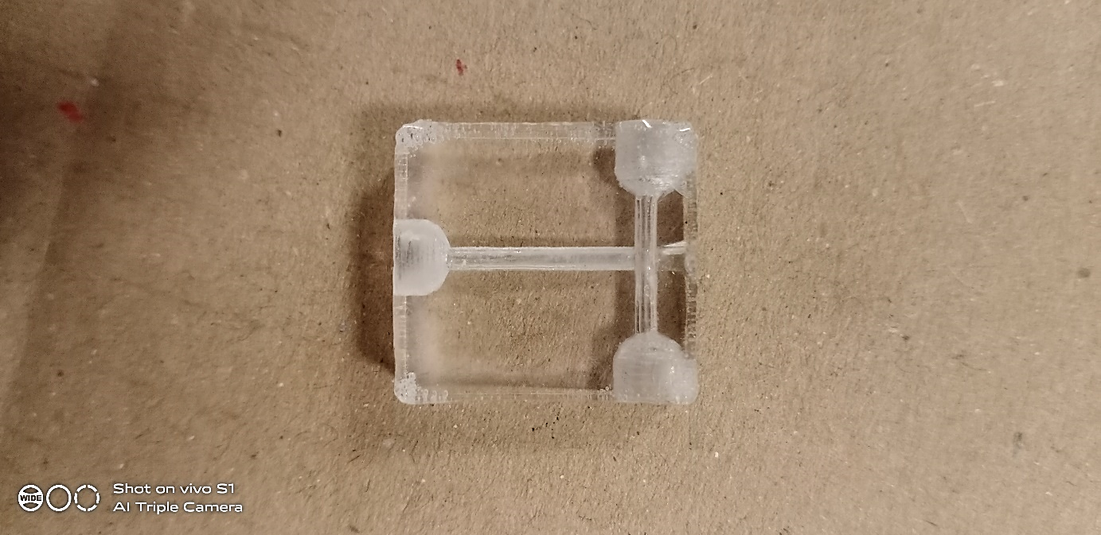
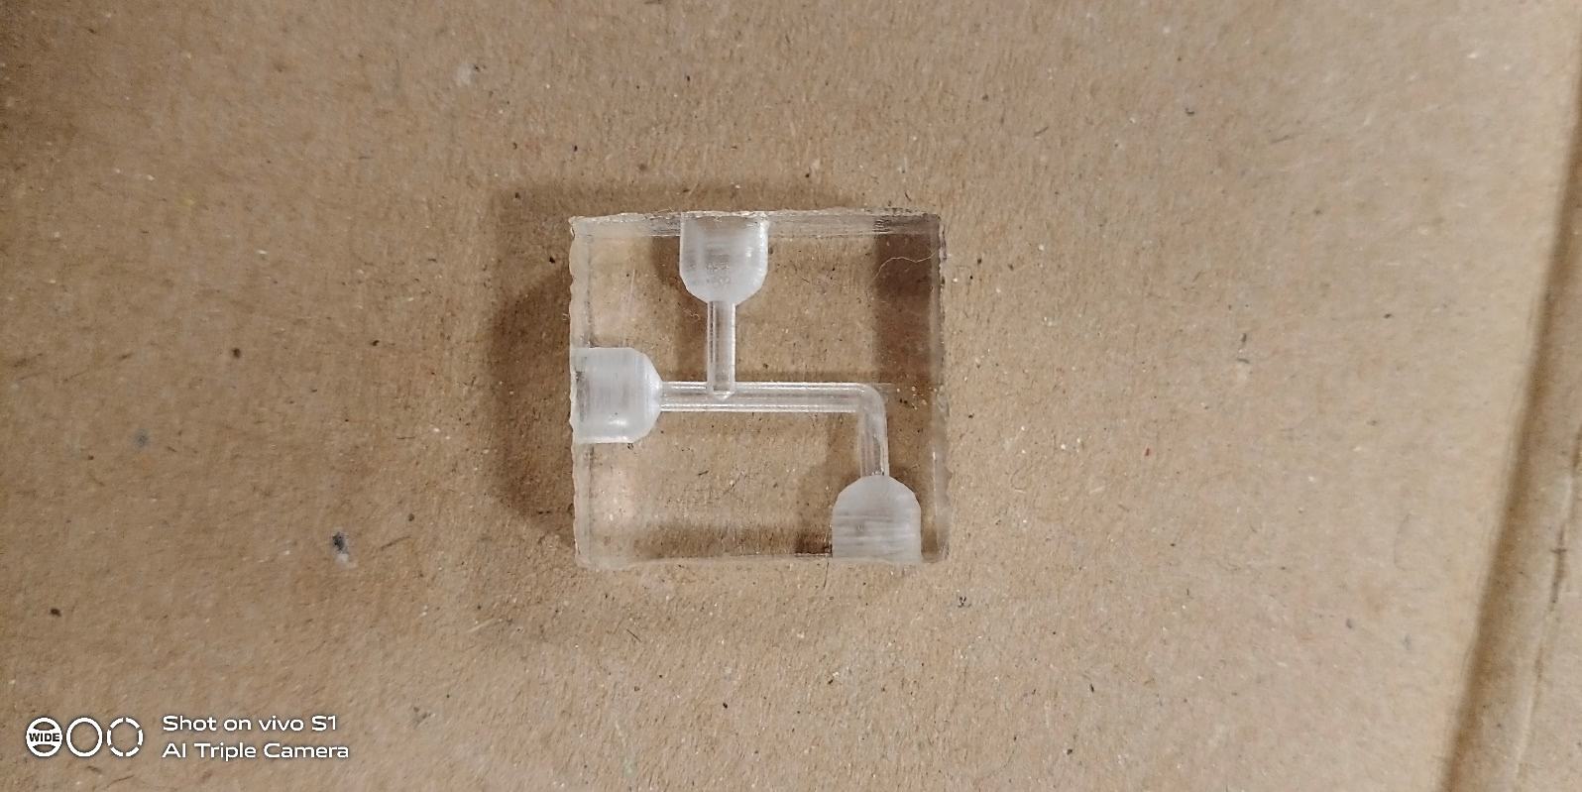
Methodology (Objective 1)
(a)
12.75 mm
(b)
Inlet A
Interrogation region
Inlet B
9 mm
Outlet
Outlet
Inlet B
Inlet A
Interrogation region
7.5 mm
Figure 4: Fabricated microfluidic (a) T-junction and (b) offset T-junction channels with inlets and outlet radius of 750 µm for micromixing experiment (20 × 17 × 8 ${mm}^{3}$)

Slide 17
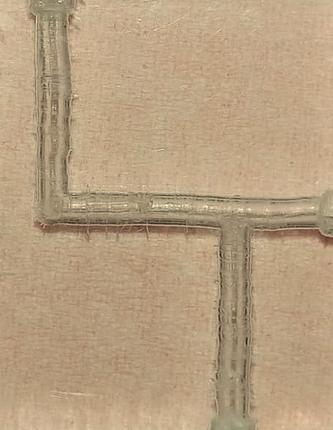
Methodology (Objective 1)
Inlet B
10 mm
Region of interest (1420 × 1060 µm² equivalent to 800 × 600 pixels)
20 mm
Outlet
Inlet A
Figure 5: Fabricated offset T-junction microchannel with inlets and outlet radius of 750 µm for droplet generation experiment (25 × 20 × 6 ${mm}^{3}$)

Slide 18
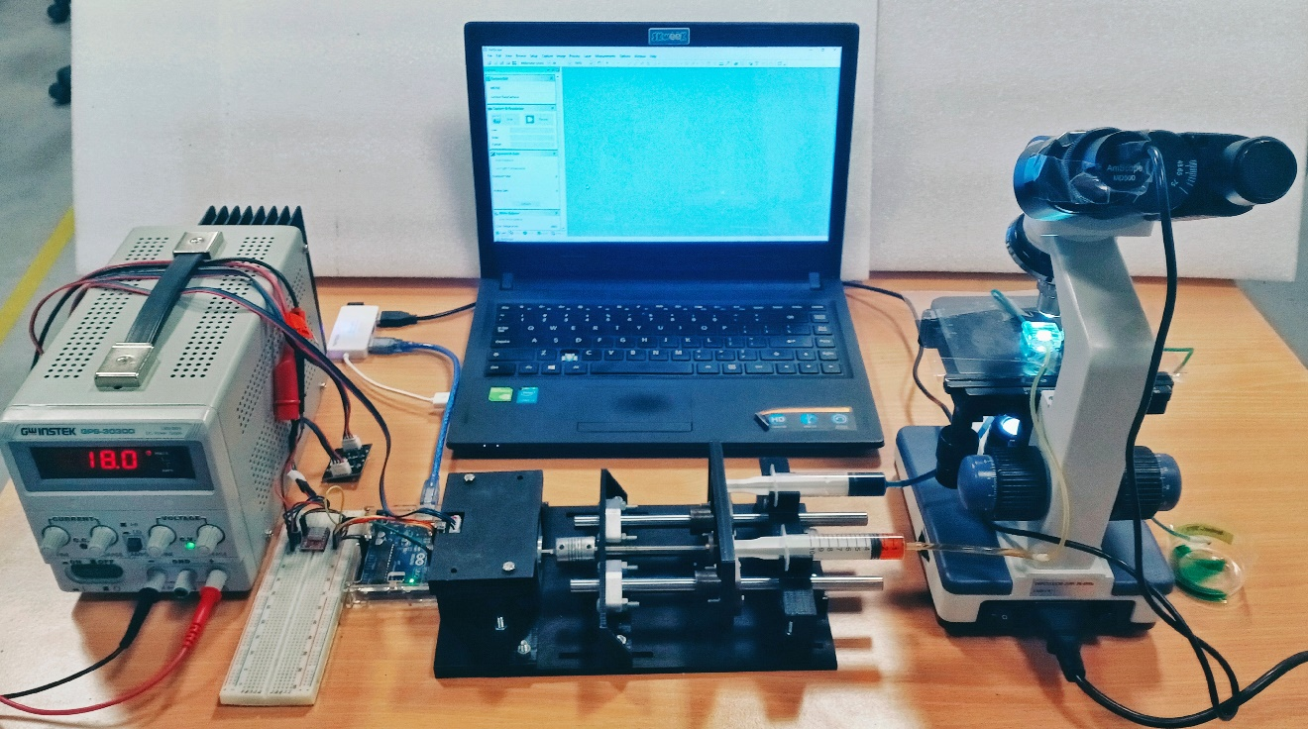
Methodology (Objective 2)
PC
Digital video microscope
DC power supply
Microcontroller and electronic hardware
Microchannel
Syringe pump
Outlet reservoir
Figure 6: Micromixing experimental setup

Slide 19
Methodology (Objective 2)
Table 3: Dissimilar liquids for micromixing experiment
Experiment | Inlet A | Inlet B | Miscibility
1 | Propan-2-ol + blue dye | Water + yellow dye | Miscible
2 | Water + yellow dye | Sodium chloride solution + blue dye | Miscible
3 | Propan-2-ol + blue dye | Sodium chloride solution + yellow dye | Immiscible
Each food grade dyes was mixed with the chosen liquids with ratio of 1:100 for each mixing experiment.
Since during the processes of mixing, the density as well as dynamic viscosity of the mixture were different, the properties of water were taken as the reference for the whole experiments (Wang et al., 2012; Viktorov et al., 2016; Mahmud & Tamrin, 2020).

Slide 20
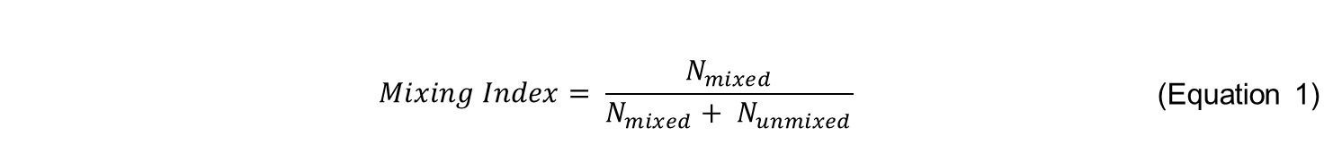
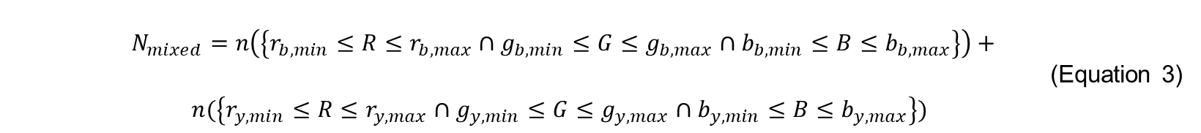
Methodology (Objective 2)
RGB Colour Model by (Mahmud & Tamrin, 2020):
 | $$Mixing Index= \frac{N_{mixed}}{N_{mixed}+ N_{unmixed}}$$ | (Equation 1)
$N_{mixed}$ and $N_{unmixed}$ are the number of pixels classified as mixed and unmixed solution, respectively, based on the following:
 | $N_{mixed}=n(\left\{r_{g,min}≤R≤r_{g,max}∩g_{g,min}≤G≤g_{g,max}∩b_{g,min}≤B≤b_{g,max}\right\})$ | (Equation 2)
 | $N_{mixed}=n\left(\left\{r_{b,min}≤R≤r_{b,max}∩g_{b,min}≤G≤g_{b,max}∩b_{b,min}≤B≤b_{b,max}\right\}\right)+n(\left\{r_{y,min}≤R≤r_{y,max}∩g_{y,min}≤G≤g_{y,max}∩b_{y,min}≤B≤b_{y,max}\right\})$ | (Equation 3)
The number of pixels, satisfying RGB conditions, is specified using 𝑛 while ∩ symbolizes for the Boolean AND operation. The letters ′𝑟′, ′𝑔′ and ′𝑏′ are used to identify the red, green and blue values respectively. The letters in the subscripts (𝑔, 𝑏 and 𝑦) denote the respective intensity values of the RGB for green, blue and yellow pixels. Their values range between 0 (unmixed solution) to 1 (fully mixed solution).

Slide 21
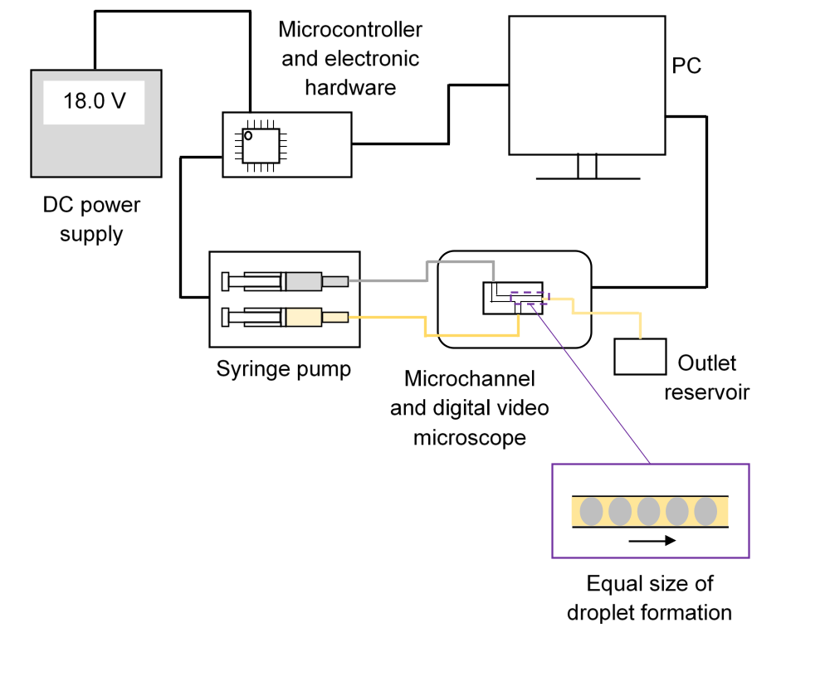
Methodology (Objective 3)
Table 4: Controlled parameters for droplet generation experiment
Parameter | Value
Exposure time | 3.906 ms
Colour temperature | 5547
Frame rate | 21.8 fps
Resolution | 800 × 600 pixels
Motor step | 5
Flow rate of liquid at the inlets | 0.16 mm³/s
Figure 7: Schematic diagram of the experimental setup for droplet generation

Slide 22
Methodology (Objective 3)
Table 6: Specification of seeding particle (Turner et al., 2018)
Table 5: Specification of continuous and dispersed phase
Composition/ Material | Polystyrene
Manufacturer | Thermo Scientific™ 4210A
Diameter | 10 µm ± 0.08 µm
Concentration | 0.2% solids
Density | 1050 kg/cm³
Refractive index | 1.59 at 589 nm (25°C)
Food grade palm olein (Siddique et al., 2010) | Parameter | Distilled water
917 | Density (kg/m³) | 997
7.97 × 10⁻² | Dynamic viscosity (Pa·s) | 8.90 × 10⁻⁴
The seeding particles was mixed with distilled water with ratio of 1:4 for each experiment.
The food grade palm olein and the seeding particles were assumed to have the same density and dynamic viscosity as distilled water.
Due to the particles small size and minimal density difference between the particles and water, they are assumed to faithfully follow the flow of water (Santiago et al., 1998; Tamrin et al., 2015).

Slide 23
Methodology (Objective 3)
Micro-PIV Lab (Thielicke & Stamhuis, 2014; Thielicke, 2014):
The region of interest was set to the whole area of the 800×600 pixels frame (1420×1060 µm²).
For image pre-processing, contrast limited adaptive histogram equalization (CLAHE) was applied to the images for visibility enhancement (Yadav et al., 2014).
It is noted that the average seeding density is 5 particles per 32×32 window while the threshold parameter for the signal-to-noise ratio was set at 1.5.
The resulting velocity fields have a spatial resolution of 28.4 µm × 28.4 µm × 55.5 µm. Then, the images were processed by cross-correlation function in order to obtain the raw velocity vectors of the liquids.
To compensate for aberration (Tamrin et al., 2015; Tamrin et al., 2015), the calibration was performed using the image of 10 µm polystyrene microsphere flowing inside the microchannel, which resulted to 6×6 pixels based on 4× magnification of digital video microscope.
The vector validation was done to eliminate some incorrect vectors remaining from noise peaks in the correlation function.

Slide 24
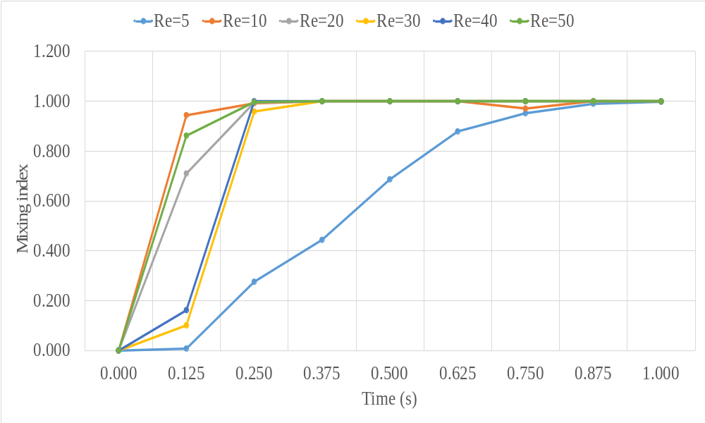
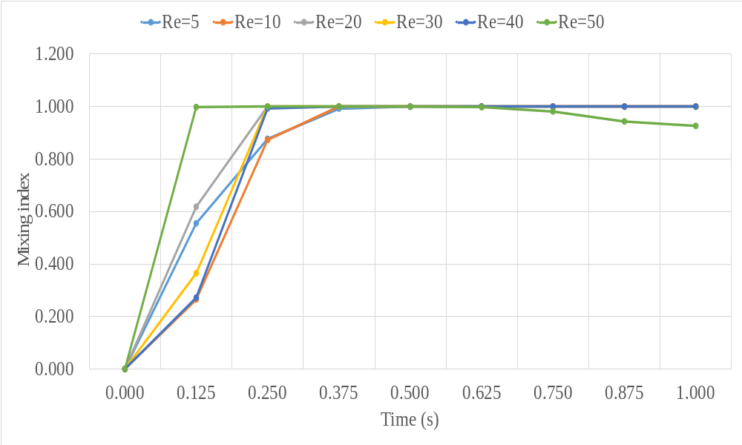
Results - Micromixing
Figure 8: Mixing index of propan-2-ol and water at T-junction
Figure 9: Mixing index of propan-2-ol and water at offset T-junction

Slide 25
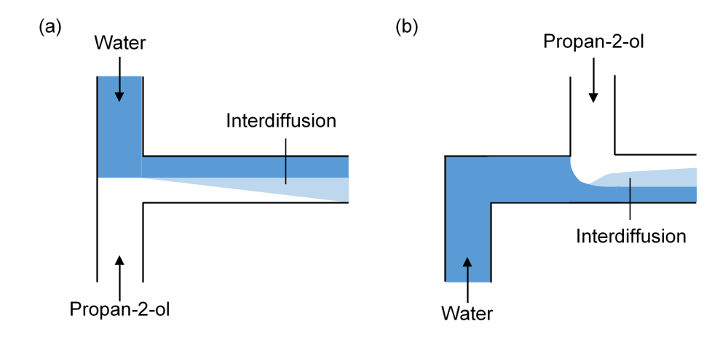
Results - Micromixing
Figure 10: Top view indicating schematically the interdiffusion layer of miscible propan-2-ol-water micromixing in (a) T-junction and (b) offset T-junction microchannels

Slide 26
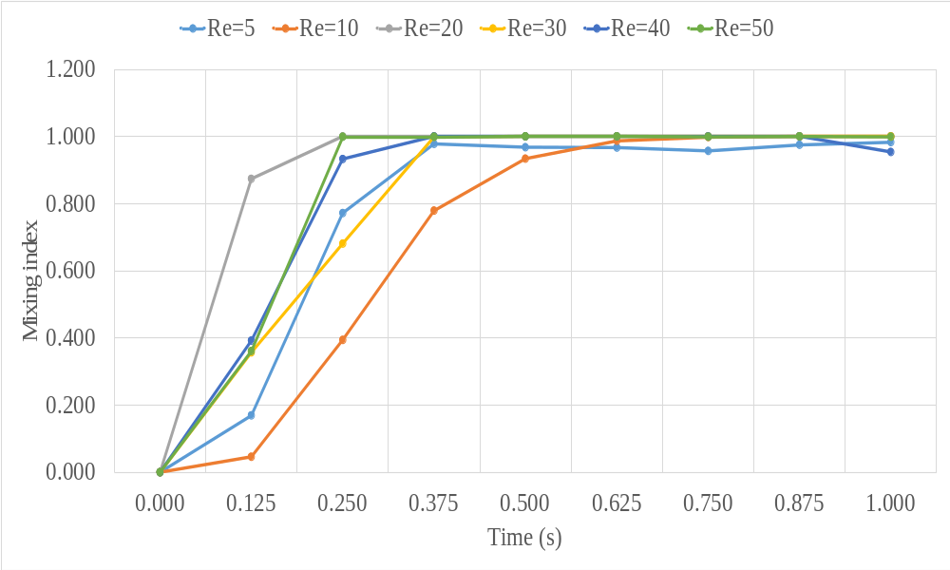
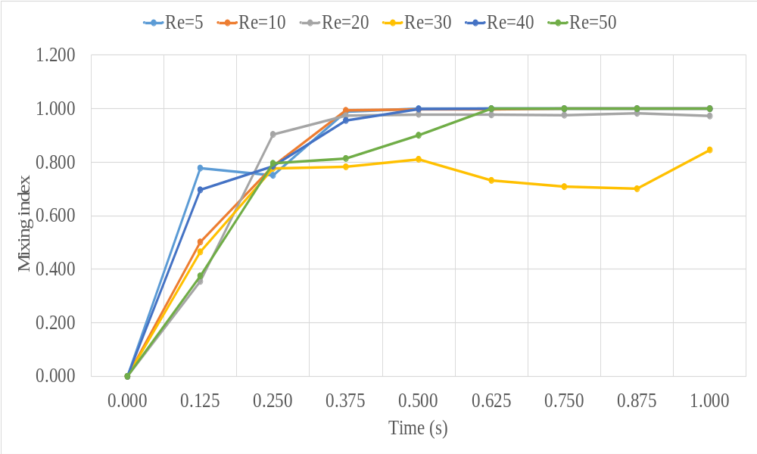
Results - Micromixing
Figure 11: Mixing index of water and sodium chloride solution at T-junction
Figure 12: Mixing index of water and sodium chloride solution at offset T-junction

Slide 27
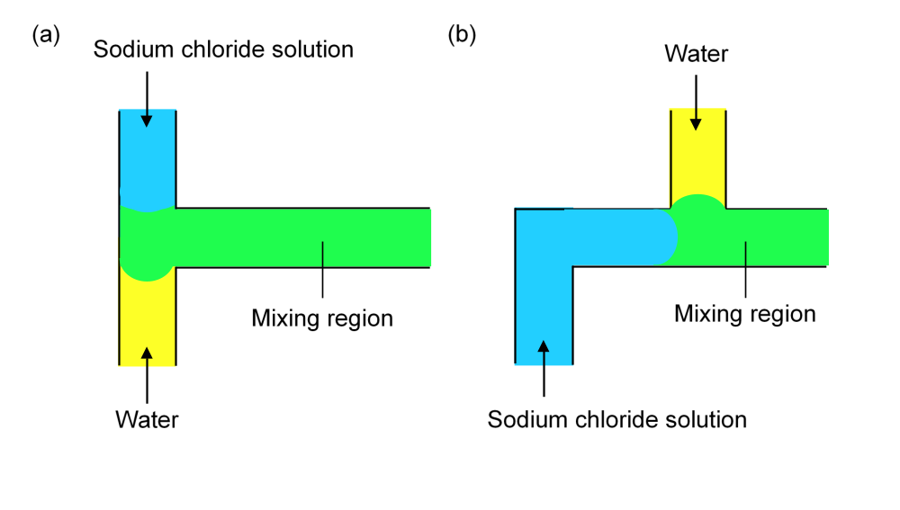
Results - Micromixing
Figure 13: The schematic diagram mixing of water and sodium chloride solution in (a) T-junction, and (b) offset T-junction microchannels

Slide 28
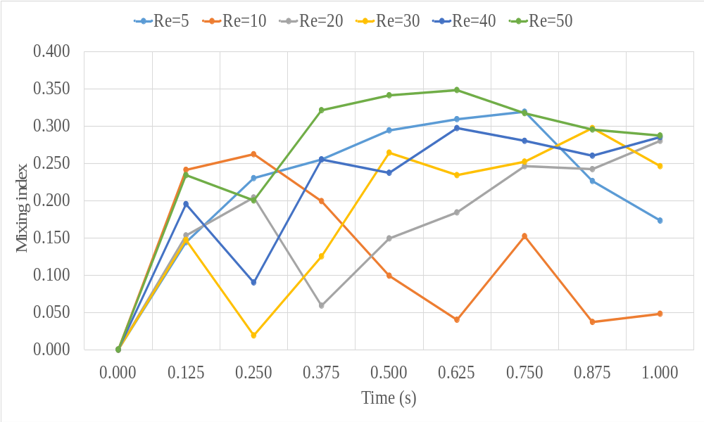
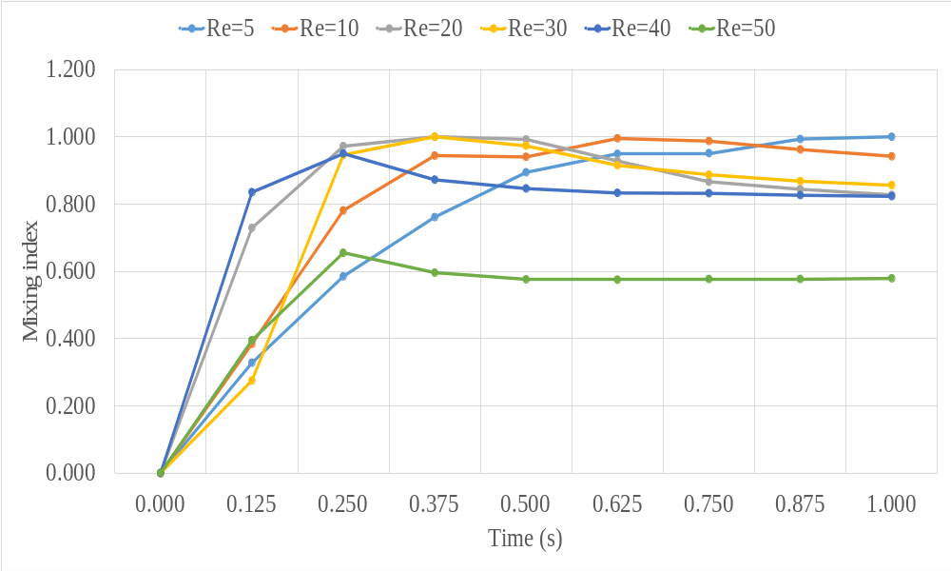
Results - Micromixing
Figure 14: Mixing index of propan-2-ol and sodium chloride solution at T-junction
Figure 15: Mixing index of propan-2-ol and sodium chloride solution at offset T-junction

Slide 29
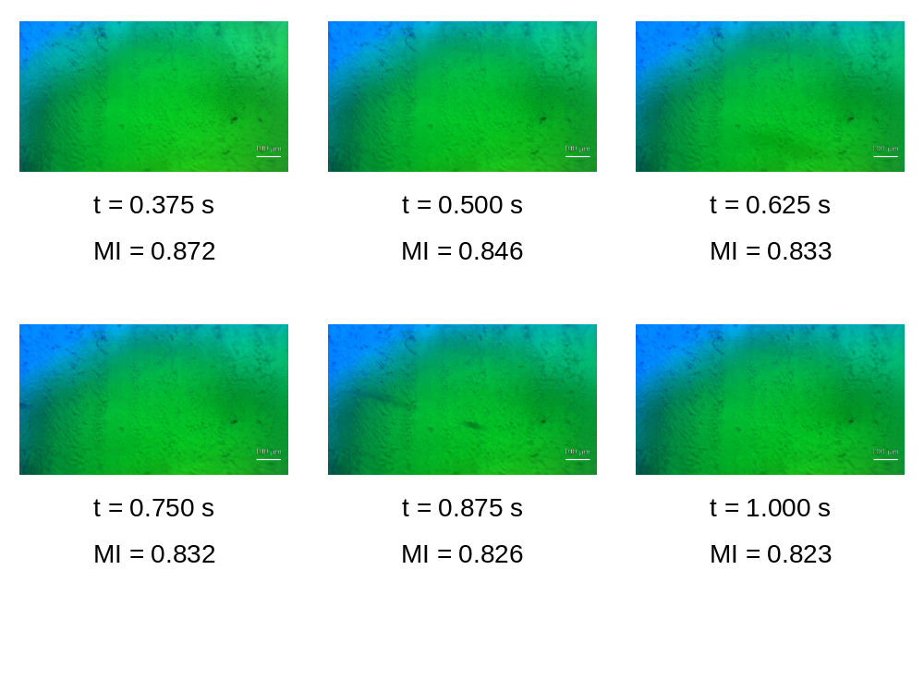
Results - Micromixing
Figure 16: Actual mixing images (1400 µm length and 790 µm width) of blue dye in propan-2-ol and yellow dye in sodium chloride solution within offset T-junction microchannel at Re of 40. MI stands for mixing index.

Slide 30
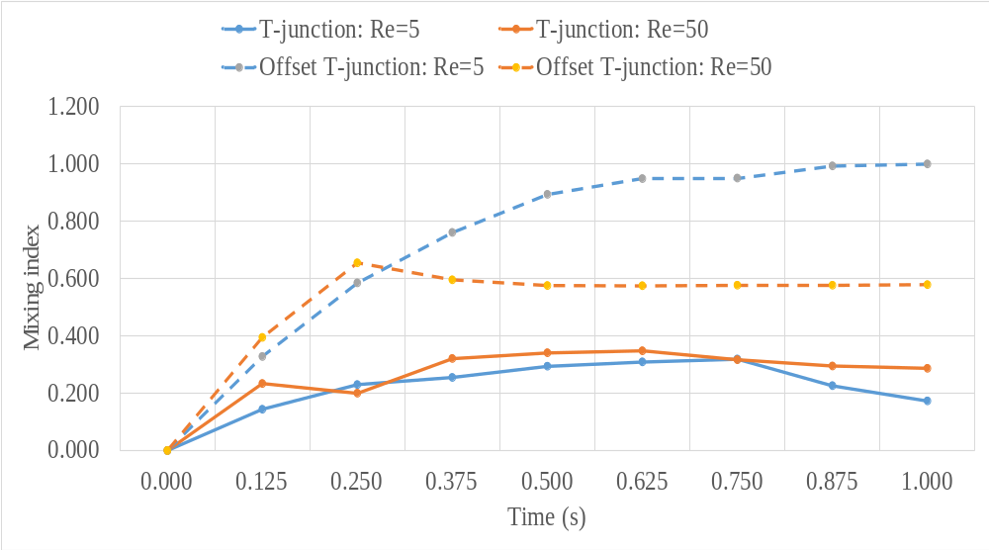
Results - Micromixing
Figure 17: Comparison of mixing index between propan-2-ol and sodium chloride solution at different Re in T-junction and offset T-junction microchannels

Slide 31
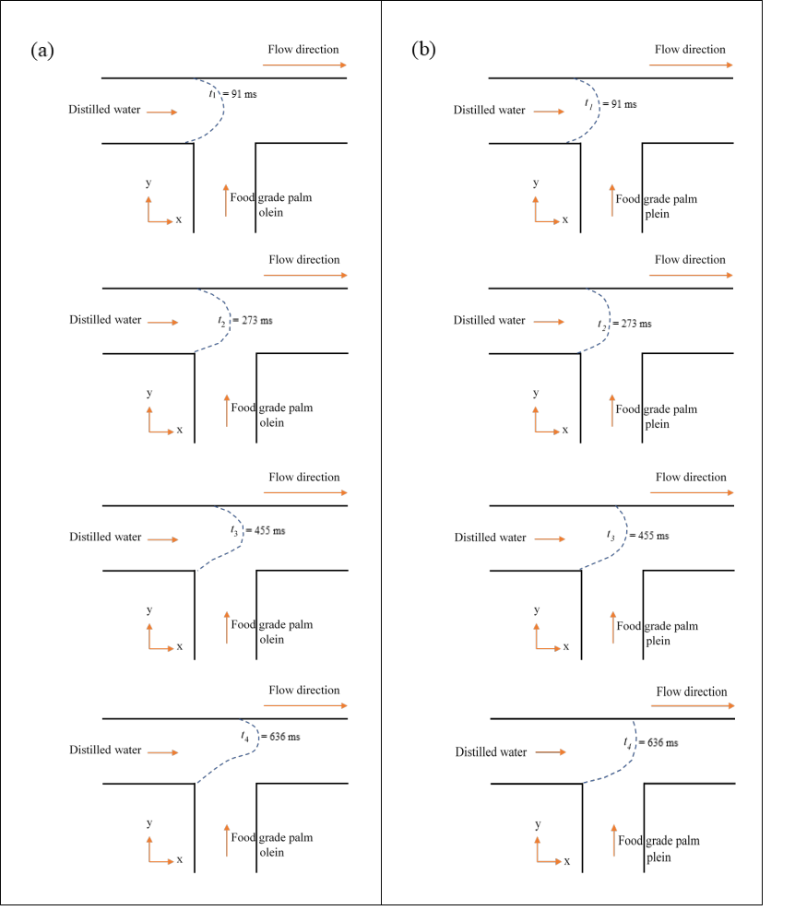
Results – Droplet Generation
When the droplet reached the junction, the oil pushed the water droplet upwards and cause an irregular shape at the bottom of the droplet as can be seen at t = t3.
This point is named as thread expansion stage and the period is called expansion time (Fu et al., 2009). The droplet is likely starting to be in the break-up process. The length increases gradually while the width increases moderately.
As it reached t = t4, the cross-flowing liquids drove the thread in its axial direction and a visible neck formed.
Figure 18: The evolution of water droplets for offset T-junction microchannels with radius of (a) 400 µm, and (b) 750 µm

Slide 32
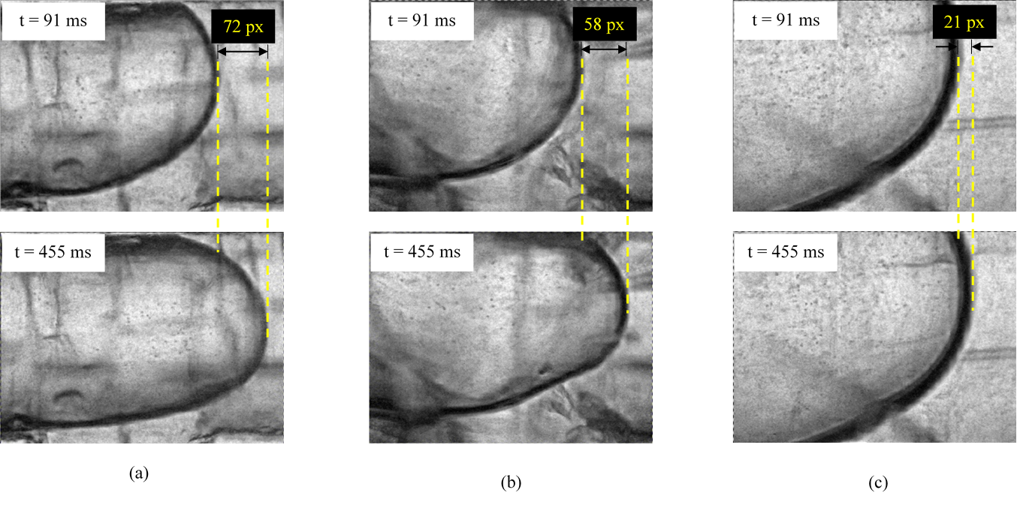
Results – Droplet Generation
Table 7: Theoretical and experimental velocity of water droplets
Inlet and outlet radius of offset T-junction microchannel (µm) | Theoretical velocity based on Re (mm/s) | Experimental velocity (mm/s)
400 | 0.322 | 0.330
500 | 0.206 | 0.266
750 | 0.092 | 0.096
1000 | 0.051
Figure 19: The motion of water droplets after 364 ms within radius of (a) 400 µm, (b) 500 µm, and (c) 750 µm offset T-junction microchannels

Slide 33
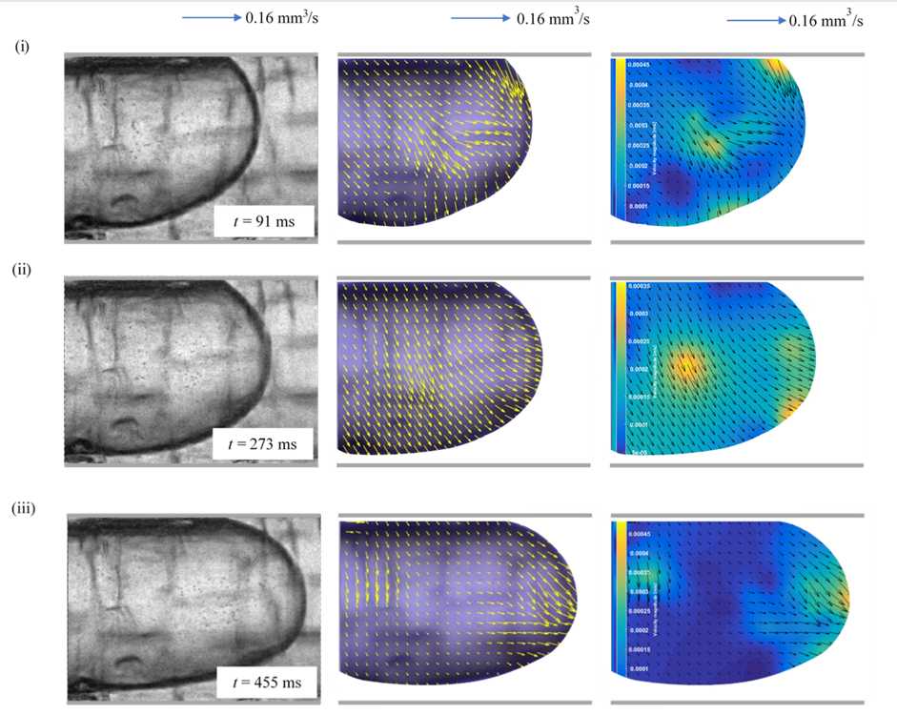
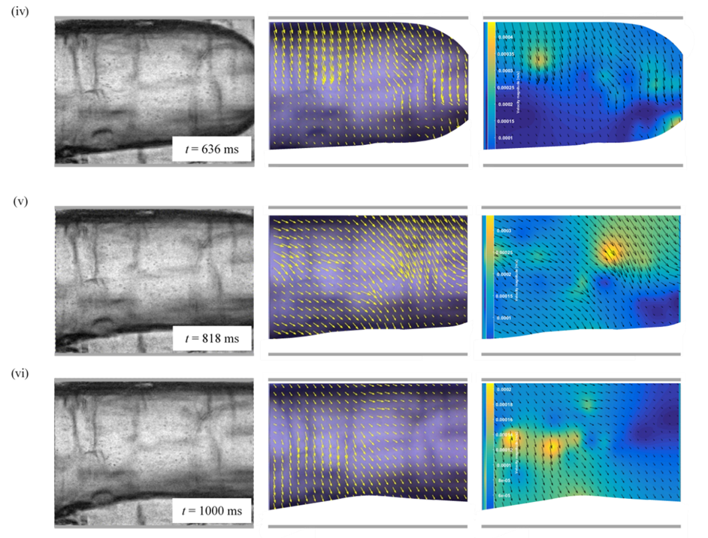
Results – Droplet Generation
Figure 20: Pre-processing image, vector and velocity magnitude for offset T-junction microchannel with radius of 400 µm

Slide 34
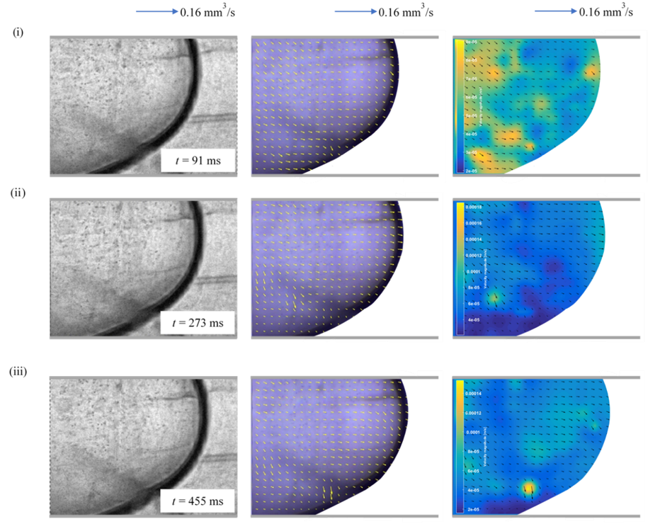
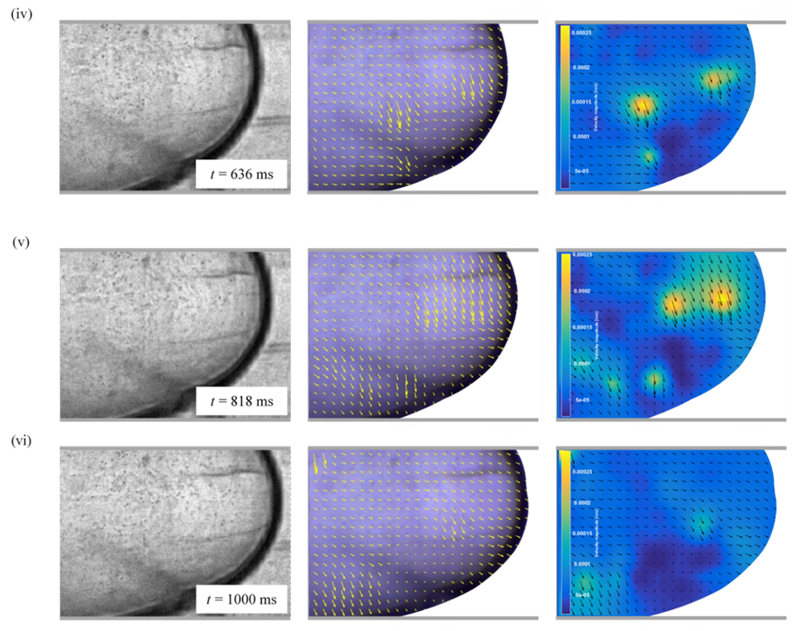
Results – Droplet Generation
Figure 21: Pre-processing image, vector and velocity magnitude for offset T-junction microchannel with radius of 750 µm

Slide 35
Conclusion - Micromixing
For miscible mixing experiments i.e., propan-2-ol and water, water and sodium chloride solution, both microchannels show that mixing performance of these liquids for each Re is directly proportional to the mixing time.
On the other hand, it is nearly impossible to mix propan-2-ol and sodium chloride solution in the microchannel. Nevertheless, offset T-junction microchannel offers better mixing of these two immiscible liquids compared to T-junction microchannel at both low and high Re. When the inlets of T-junction having an offset of 7.5 mm, the mixing quality increases by twice or more.

Slide 36
Conclusion – Droplet Generation
The experimental results show that increasing in the radius of offset T-junction microchannel leads to the increase in cross-sectional area and the decrease of distilled water phase’s velocity.
The size of the droplets is getting bigger and nearly equal to the microchannel’s width as the radius of microchannel increases.
This concludes that the vector and velocity magnitude data in a good agreement with Hagen-Poiseuille flow equation, meaning that a small increase in the channel’s internal diameter yields a significant increase in overall flow of a liquid.

Slide 37
References
Ansari, M. A., Kim, K.-Y., & Kim, S. M. (2018). Numerical and experimental study on mixing performances of simple and vortex micro T-mixers. Micromachines, 9(5), 204.
Darekar, M., Singh, K. K., Mukhopadhyay, S., & Shenoy, K. T. (2017). Liquid–liquid twophase flow patterns in Y-junction microchannels. Industrial & Engineering Chemistry Research, 56(42), 12215-12226.
Deng, C., Huang, W., Wang, H., Cheng, S., He, X., & Xu, B. (2018). Preparation of Micron-Sized Droplets and Their Hydrodynamic Behavior in Quiescent Water. Brazilian Journal of Chemical Engineering, 35(2), 709-720.
Dundi, M., VRK, R., & VP, C. (2019). Characterization of enhanced liquid mixing in T‐T mixer at various Reynolds numbers. Asia‐Pacific Journal of Chemical Engineering, 14(2), e2298.
Fu, T., Ma, Y., Funfschilling, D., & Li, H. Z. (2009). Bubble formation and breakup mechanism in a microfluidic flow-focusing device. Chemical Engineering Science, 64(10), 2392-2400.
Kashid, M. N., & Agar, D. W. (2007). Hydrodynamics of liquid–liquid slug flow capillary microreactor: flow regimes, slug size and pressure drop. Chemical Engineering Journal, 131(1-3), 1-13.

Slide 38
References
Liu, Z., Zhang, L., Pang, Y., Wang, X., & Li, M. (2017). Micro-PIV investigation of the internal flow transitions inside droplets traveling in a rectangular microchannel. Microfluidics and Nanofluidics, 21(12), 180.
Mahmud, F., & Tamrin, K. F. (2020). Method for determining mixing index in microfluidics by RGB color model. Asia‐Pacific Journal of Chemical Engineering, e2407.
Orsi, G., Roudgar, M., Brunazzi, E., Galletti, C., & Mauri, R. (2013). Water–ethanol mixing in T-shaped microdevices. Chemical Engineering Science, 95, 174-183.
Salim, A., Fourar, M., Pironon, J., & Sausse, J. (2008). Oil–water two‐phase flow in microchannels: Flow patterns and pressure drop measurements. The Canadian Journal of Chemical Engineering, 86(6), 978-988.
Shen, F., Li, Y., Liu, Z., & Li, X. (2017). Study of flow behaviors of droplet merging and splitting in microchannels using Micro-PIV measurement. Microfluidics and Nanofluidics, 21(4), 66.
Siddique, B. M., Ahmad, A., Ibrahim, M. H., Hena, S., & Rafatullah, M. (2010). Physicochemical properties of blends of palm olein with other vegetable oils. Grasas y Aceites, 61(4), 423-429.

Slide 39
References
Solehati, N., Bae, J., & Sasmito, A. P. (2014). Numerical investigation of mixing performance in microchannel T-junction with wavy structure. Computers & Fluids, 96, 10-19.
Thielicke, W., & Stamhuis, E. (2014). PIVlab–towards user-friendly, affordable and accurate digital particle image velocimetry in MATLAB. Journal of open research software, 2(1).
Thielicke, W. (2014). The flapping flight of birds. Diss. University of Groningen.
Turner, A., Yandrofski, K., Telikepalli, S., King, J., Heckert, A., Filliben, J., . . . Schiel, J. E. (2018). Development of orthogonal NISTmAb size heterogeneity control methods. Analytical and Bioanalytical Chemistry, 410(8), 2095-2110.
Viktorov, V., Mahmud, M. R., & Visconte, C. (2016). Numerical study of fluid mixing at different inlet flow-rate ratios in Tear-drop and Chain micromixers compared to a new HC passive micromixer. Engineering Applications of Computational Fluid Mechanics, 10(1), 182-192.

Slide 40
References
Wang, W., Zhao, S., Shao, T., Jin, Y., & Cheng, Y. (2012). Visualization of micro-scale mixing in miscible liquids using μ-LIF technique and drug nano-particle preparation in T-shaped micro-channels. Chemical Engineering Journal, 192, 252-261.
Yao, J., Lin, F., Kim, H. S., & Park, J. (2019). The effect of oil viscosity on droplet generation rate and droplet size in a T-junction microfluidic droplet generator. Micromachines, 10(12), 808.
Zhang, J.-w., Liu, S.-f., Cheng, C., Li, W.-f., Xu, X.-l., Liu, H.-f., & Wang, F.-c. (2019). Investigation of three-dimensional flow regime and mixing characteristic in T-jet reactor. Chemical Engineering Journal, 358, 1561-1573.
Zhu, P., Tang, X., & Wang, L. (2016). Droplet generation in co-flow microfluidic channels with vibration. Microfluidics and Nanofluidics, 20(3), 47.

Slide 41
Publications
Ringkai, H., Tamrin, K. F., Sheikh, N. A., & Barroy, P. (2021). Characterization of dissimilar liquids mixing in T-junction and offset T-junction microchannels. Proceedings of the Institution of Mechanical Engineers, Part E: Journal of Process Mechanical Engineering, 235(6), 1797-1806. (Published, ISI Q3, Impact factor 1.606)
Ringkai, H., Tamrin, K. F., Sheikh, N. A., & Mohamaddan, S. (2021). Evolution of water-in-oil droplets in t-junction microchannel by micro-piv. Applied Sciences, 11(11), 5289. (Published, ISI Q2, Impact factor 2.474)

