Slide 1
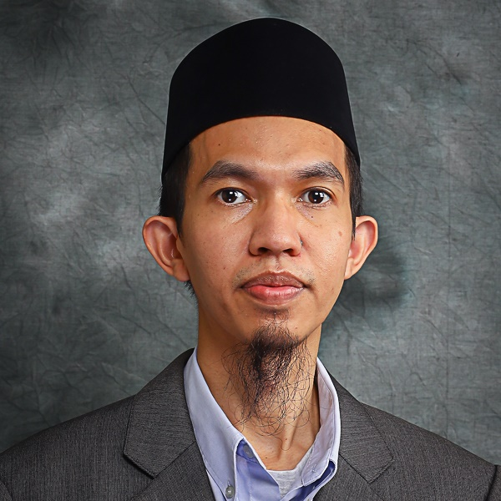
















Ir Dr Khairul Fikri Tamrin
Senior Lecturer
Universiti Malaysia Sarawak
PERSONAL
INFO
ABOUT ME
PUBLICATIONS
Professional Engineer with research focus in laser materials processing, laser optical measurement and fluid physics
Welcomes collaboration in research, innovation and publication to accelerate sustainable future for all
36
Impact Journals (WoS)
PERSONAL WEBSITE
47
Science Citation Index
fikritamrin.com
SCOPUS
NATIONALITY
3
Journal and Conference Paper
Malaysian
Book Chapter
10
5
RM530,466
Laser and microfluidics
YEARS OF RESEARCH & TEACHING EXPERIENCE
h-index
Scopus
External Grants
Grant Amount as Principal Investigator
5
International Collaborators
14 years
France, United Kingdom, Japan, Australia, Pakistan
CONTACT
INFO
CONTRIBUTIONS
THESIS EXAMINER
HEAD OF STRATEGY
INTERNATIONAL (1 PhD)
INTERNAL (4 MSC)
PHONE
FACULTY OF ENGINEERING
+601115653090
HEAD OF RESEARCH ENHANCEMENT UNIT
JOURNAL REVIEWER
13 MANUSCRIPTS (WoS & SCOPUS)
EMAIL
RESEARCH, INNOVATION AND ENTERPRISE CENTRE (RIEC)
PENCERAMAH
tkfikri@unimas.my
INTELECTUAL PROPERTIES (INTERNAL)
RESEARCH & PUBLICATIONS (EXTERNAL)
OFFICIAL WEBSITE
QUALITY MANAGEMENT UNIT
expert.unimas.my/profile/2739
FACULTY OF ENGINEERING
COMMUNITY PROJECT
ACCREDITATION UNIT
FRONTLINER LEADER: PROTECTIVE SHIELD PHLEBOTOMY PROJECT (SARAWAK GENERAL HOSPITAL)
DEPT OF MECHANICAL & MANUFACTURING ENGINEERING
LANGUAGES
EXPERTISE
MAIN SUPERVISOR
ENGLISH
13
Master by Research (Graduated)
MALAY
50
Fluid Dynamics
Master by Research (In Progress)
ARABIC
Laser Material Processing
PhD (Awaiting Viva Voce)
25
Master by Coursework (Graduated)
HOBBIES
Laser Optical Measurement
12
Applied Mathematics

